Slide 1
MORPHFUN
Group 04
Armando Boemio Lorenzo Brugioni Gabriele Maucione Paolo Sani
Exam Presentation 26/06/2022 A.Y. 2021/2022
PROJECT PRESENTATION
BOOST YOUR CREATIVITY

Slide 2
Playing an instrument is a lot of fun, but what if you could have
MORPHFUN?

Slide 3
01
05
MorphFun concept
Code Architecture
02
06
Timbre Transfer
Live Demo
03
Pose Estimation
07
Possible Improvements
04
Graphical User Interface

Slide 4
MORPHFUN IDEA
MorphFun is a Timbre Transfer application, that relies on a
Pose Estimation approach to let the user choose the instrument
Timbre Transfer: it changes the timbre of an input sound
→ enormous boost in
CREATIVITY
Pose Estimation: thought to make the application
an immersive and funny experience

Slide 5
RESOURCES
HOW IT WORKS
The user live records an audio: the system loops it until another recording is enabled or the application is closed
While the loop is on, the system continuously checks – by the use of the input camera or webcam – for the pose provided by the user
Each pose is assigned to an instrument: if the system recognizes the pose of the violin, the output looping audio is morphed as it was played by a violin

Slide 6
HOW IT WORKS - USER INTERACTION
Recording
POSing
LISTENING
The user provides the input audio
The user provides the pose of the selected instrument
The morphed audio is reproduced, the user can record again

Slide 7
HOW IT WORKS
MORPHUN
TIMBRE TRANSFER
GESTURE RECOGNITION
There are two main modules
The audio recorded by the user is morphed as it was played by one of the chosable instruments
The user selects the desired output instrument by providing the system with a pose

Slide 8
TIMBRE TRANSFER
The main operating idea of MorphFun is the Timbre Transfer

Slide 9
TIMBRE TRANSFER
Reference: Tone Transfer
The system is inspired by Tone Transfer, a webapp developed by Magenta
Tool: DDSP
The system expoilts the DDSP library, developed by Magenta
Each instrument morphing is obtained using pre-trained tunable models available with DDSP
Environment: local
The system works in a fully local fashion

Slide 10
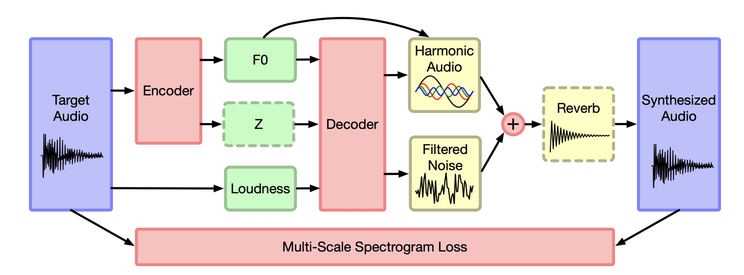
TONE TRANSFER by Magenta
Red components are part of the neural network architecture,
green components are the latent representation, and yellow components are deterministic synthesizers and effects.

Slide 11
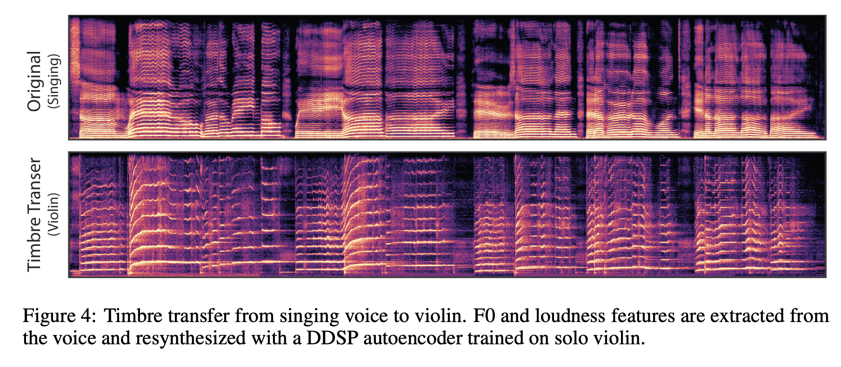
TONE TRANSFER by Magenta

Slide 12

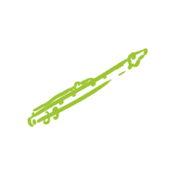
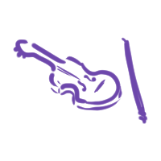

FEATURED INSTRUMENTS
Flute
Trumpet
Violin
Saxophone

Slide 13
GESTURE RECOGNITION
The video input that let the user choose

Slide 14
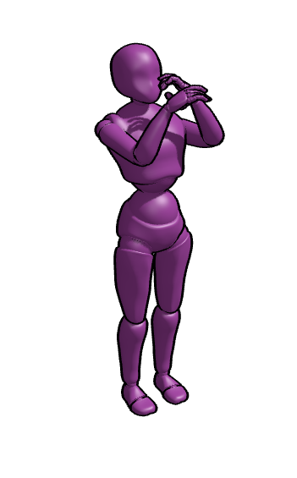
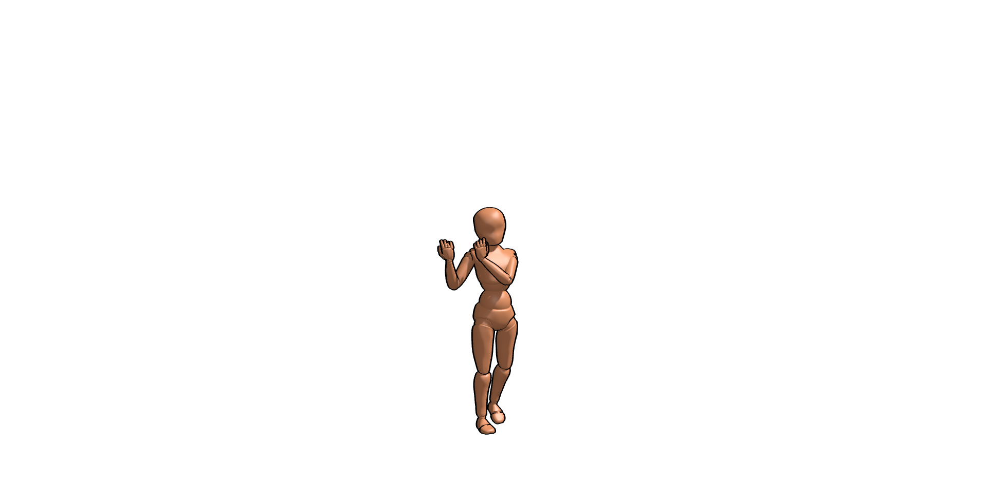


FEATURED GESTURES
Each output instrument is associated with a pose that the user can do:
Trumpet
Flute
Violin
Saxophone

Slide 15
Gesture Recognition solutions
The selection that the user acts among the different output instruments for the morphing is based on a Gesture Recognition procedure
Problem
CNN + Classification
Pose Estimation + Classification
Not feasible
Actual implemented solution

Slide 16
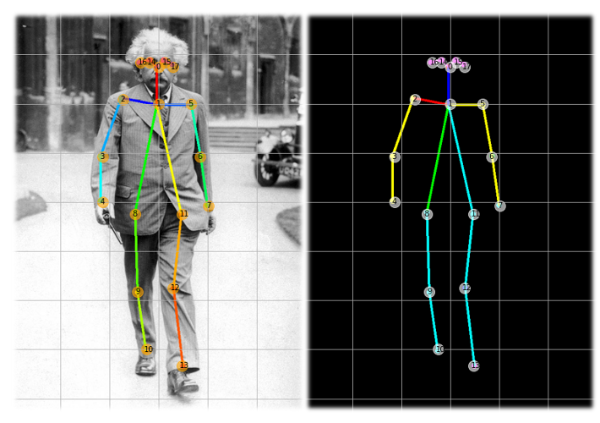
Pose Estimation
Realized with Mediapipe Holistic
The algorithm recognizes the body of the user and its position using an array of key-points
The user can be in different places, or even have different shapes
(body, clothes, ecc)
Light weight model

Slide 17
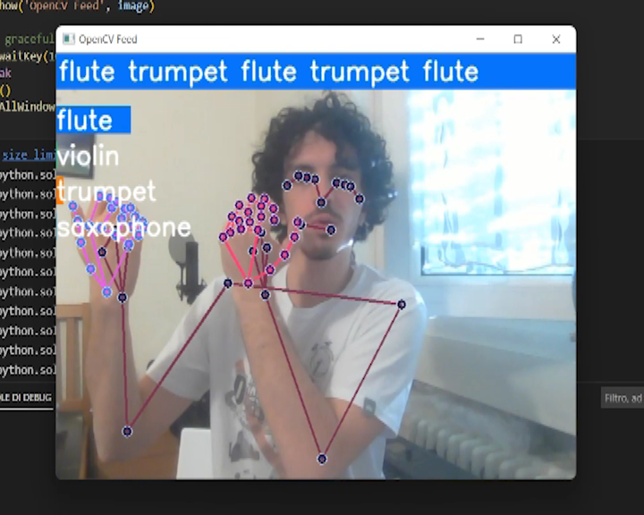
Multi-Class Classification
Takes into account the temporal evolution of the keypoints across frames
Implemented with an LSTM Neural Network
Dataset built by us in
automated fashion
Model evaluation with
real-time test

Slide 18
GRAPHICAL USER INTERFACE
How the GUI has been made

Slide 19
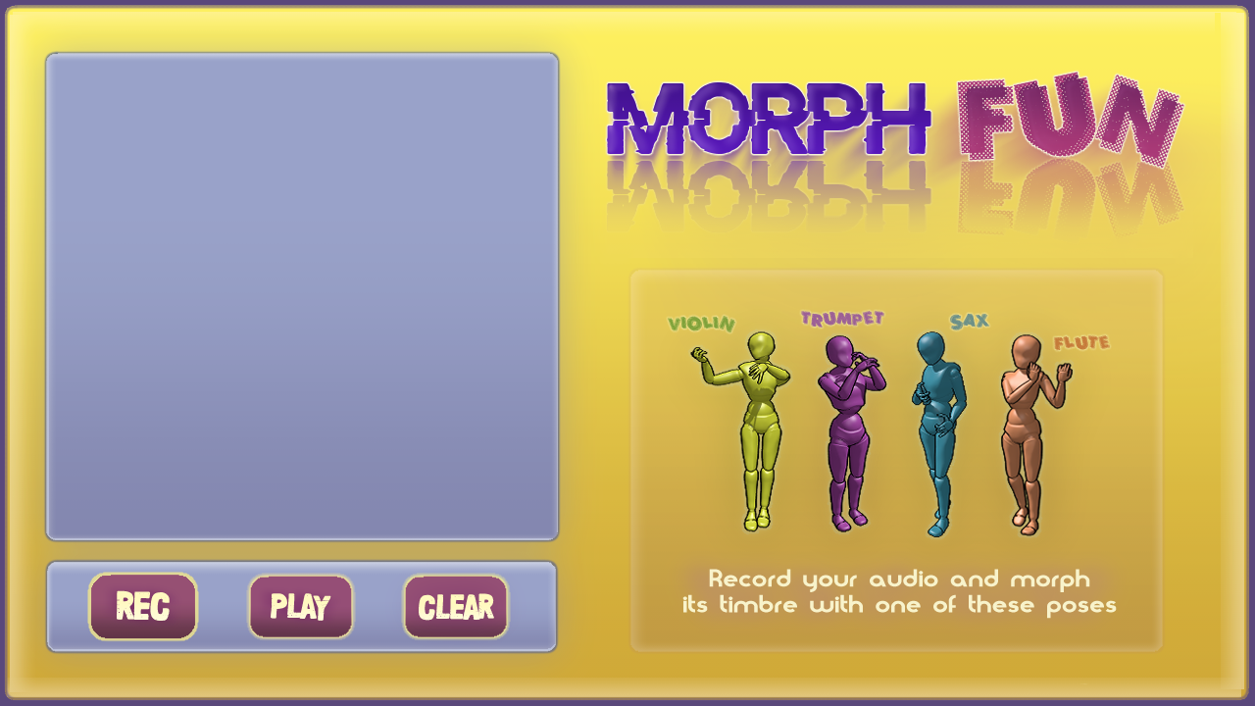
GRAPHICAL USER INTERFACE

Slide 20
GUI
Designed with
PyQt5
Writing on two queues
The webcam writes on the data queue
The buttons «Rec», «Play»/»Stop» and «Clear» write on the command queue
Very flexible, with various UI components
Thread safe

Slide 21
CODE ARCHITECTURE
How the single modules communicate

Slide 22
Model-View-Controller pattern
Model
Core data and
application main functions
View
Controller
Responsible for the
application-user interaction
Acts on the Model depending on the View state

Slide 23
MVP Pattern
gui.py
(PyQt5)
PyGame Magenta DDSP
Mediapipe
SoundDevice
controller.py
The module that implements the controller pattern
PyQt5 is the library used for the GUI
Libraries used for the model implementation
View
Controller
Model

Slide 24
Parallelism is the key
Multithreading

Slide 25
Parallelism - Multithreading
MAIN
GUI
CONTROLLER
WebCam
Morpher
Pose Estimator

Slide 26
Queueing
GUI
02
Gui writes the webcam frames on the data queue
Output
MAIN
01
04
Main generates the queue
The output pose is used to pilot the mixer
Pose Estimator
03
It reads the sequence and outputs a pose

Slide 27
Possible Improvements
Adding more instrument models
Improving usability by running the application on an embedded device

Slide 28
Repository
The whole code is available at this link:
https://github.com/PaoloSani/MorphFun

Slide 29
It’s demo time!

Slide 30
THANKS!

